Slide 1

Movie Ticket Booking Application
Team Members – Batch-2(Team_1):
Ankita A Khartmol
Dhanush S R
Pritesh Ranjan
Thrisha B V
Vidyashree G
Under the guidance of:
Prof. Saraswati K

Slide 2
Outline:
Introduction
Abstract
Background of the project
Problem Statement
Proposed System
Goals of the project
Functional and Non - Functional Requirements
Technology used
Flow Chart
Diagrams
System Implementation
System testing
Conclusion
Future Enhancement

Slide 3
Introduction:
Online Movie Ticket Booking System provide another way for the customers to buy cinema ticket. This system reduces workload on customers.
Online movie ticket booking system is basically made for providing the customers an anytime and anywhere service for booking cinema tickets and providing information about the movies and their schedule online.
Admin can also login, to insert and delete data such as movie description, movie schedule which will update the related webpage and will be accessible by the customers.

Slide 4
Abstract:
This project is aimed to provide the customers facility to book tickets for cinema halls online, anytime, anywhere.
This online ticket reservation system provides a website for cinema hall where any user of the internet can access it.
User is required to login or register into the system and needs online payment sources for booking the tickets.
The website provides complete information regarding movies on all the screens with details of show timings, available seats.
Our online tickets reservation system is one of the best option for those who cannot afford to get their tickets standing in a long queue.

Slide 5
Problem Statement
Problem Statement:
Since a long time, people have been standing in a long queue to book tickets for their favourite movies. People hate to stand in these queues but they did not have any other options. They had to waste their precious time in getting the tickets.

Slide 6
Proposed System:
The solution to the above problem, is our web application. A user just has to login/register to the website and book ticket at Mov-Ez.
The booking can be done from anywhere and at any time.
By using our web application, a user can save a lots of time and can utilize time in any other work.
This web application saves user’s time in search of a show and seats availability.

Slide 7
Goals Of Project:
The main goal of Online Movie Booking Management System is to manage the details of Movie, Ticket, Customer.
It manages all the information about the Movie, booking, Customers.
This project is totally built at administrative end and thus only the administrator is guaranteed the access.
The purpose of the project is to build an application program to reduce the manual work for managing the Booking tickets.
It tracks all the details about the Customer, Movie.

Slide 8
Functional Requirements:
Registration
Login
View Movies
Search Movie
Seat Viewing
Book Ticket
Payment
Logout
Generate ticket
Add movies
Remove movies
View users
View details of booking
Number of tickets sold

Slide 9
Non- Functional Requirements:
Security
Reliability
Performance
Availability

Slide 10
Database Design:
Admin
Id Password
Customer
Email Id Name Phone Password
Movies
Id Name Language Description
Theatre Owner
Id Password

Slide 11
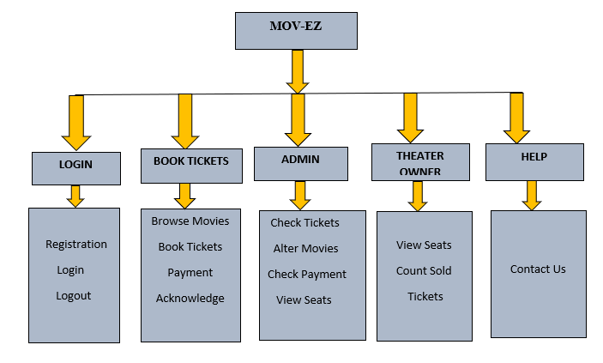
ARCHITECTURAL DIAGRAM:

Slide 12
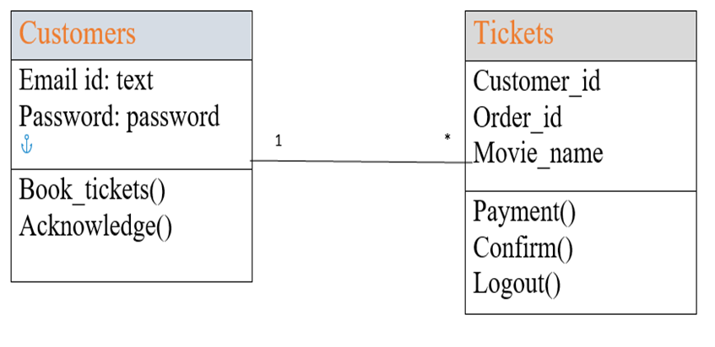
UML DIAGRAM:
CLASS DIAGRAM

Slide 13
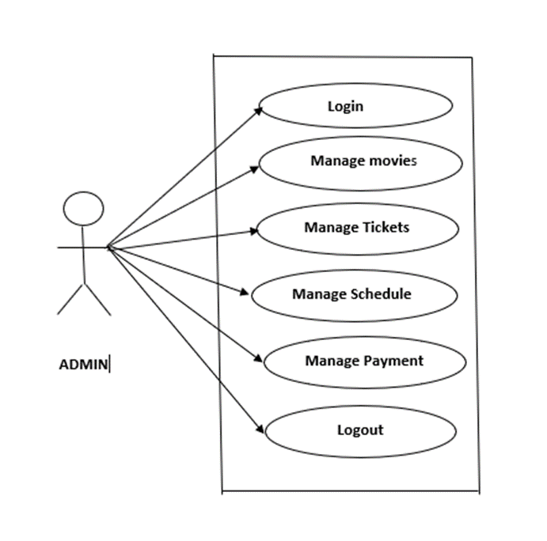
USE CASE DIAGRAM:

Slide 14
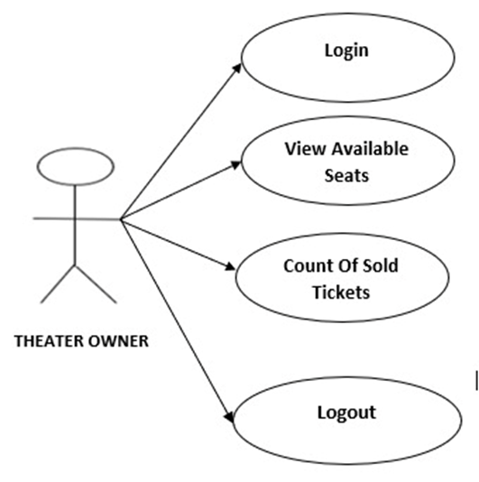
USE CASE DIAGRAM:

Slide 15
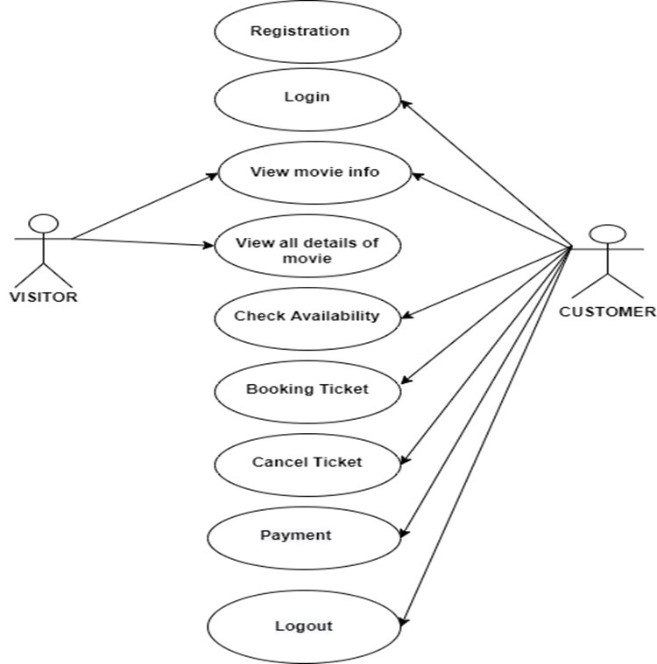
USE CASE DIAGRAM:

Slide 16
Requirements:
REQUIRED HARDWARE:
RAM: 2 GB
Hard Disk: 20.5 GB
Processor: Intel i3 (2nd Generation) 2.4 GHz
REQUIRED SOFTWARE:
Operating System: Microsoft Windows 7/8/8.1
Database: Microsoft SQL Server 2012 Tools:
Requirement: Python, HTML, CSS, SCRIPT

Slide 17
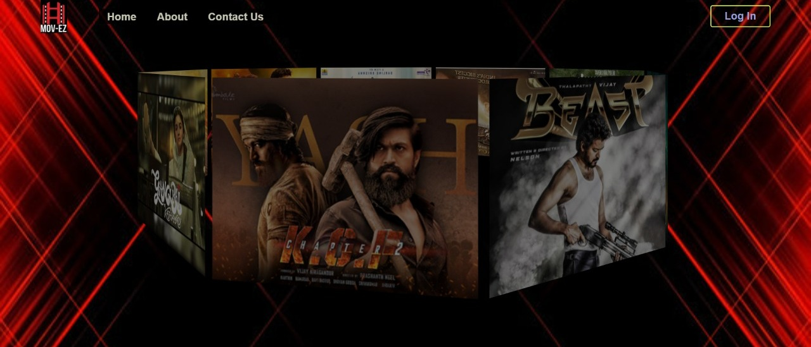
Home Page:

Slide 18
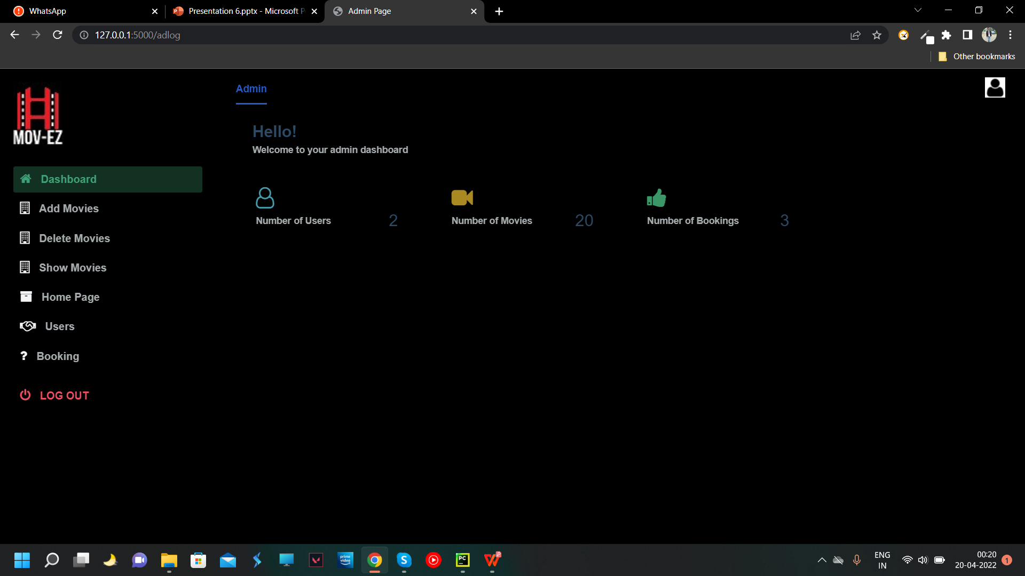
Admin Home Page:

Slide 19
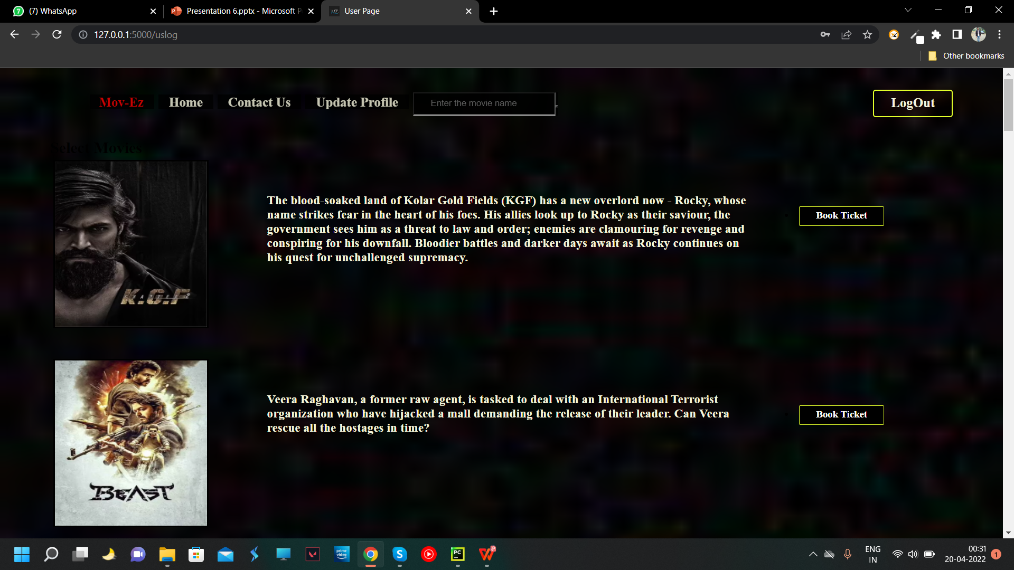
User Home page:

Slide 20
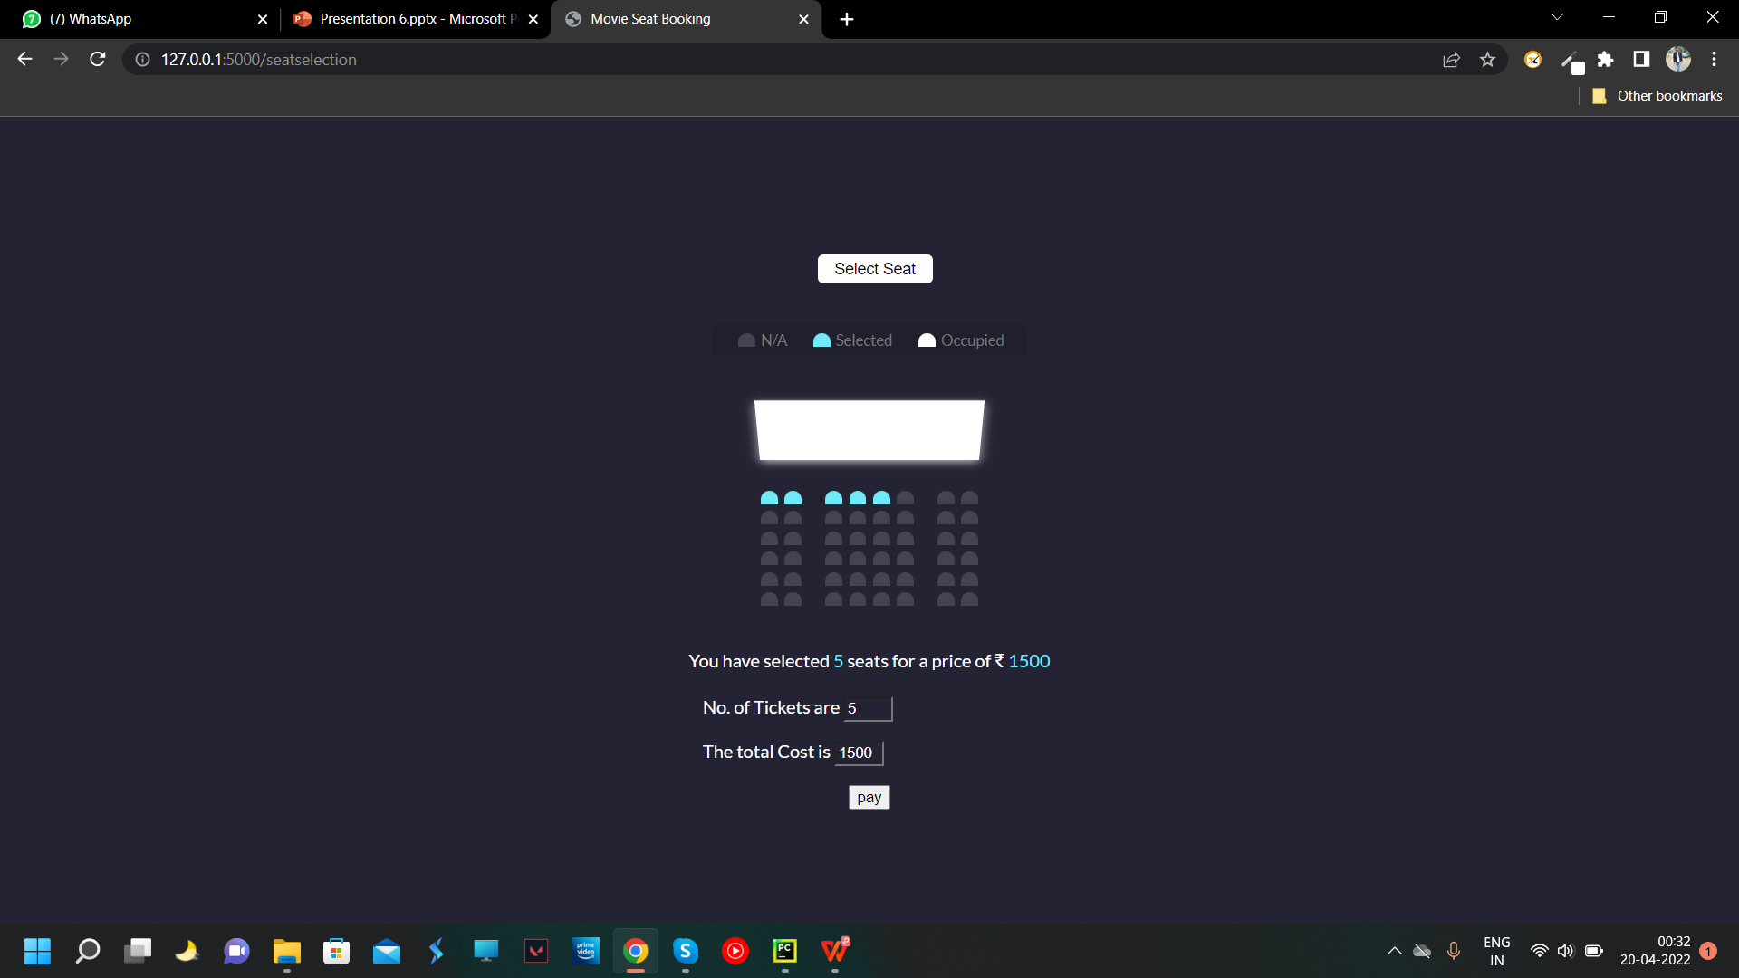
Seat View:

Slide 21
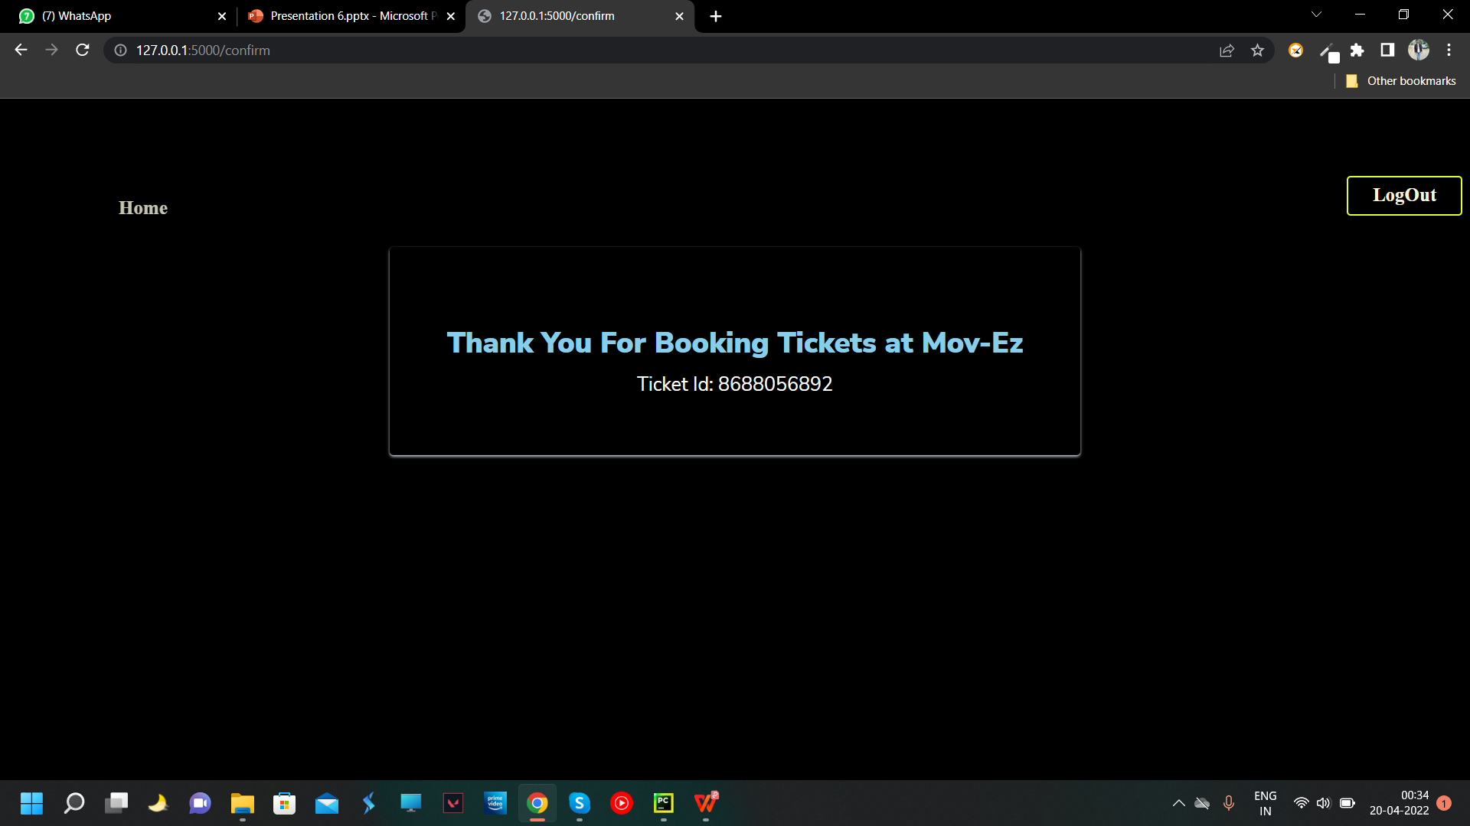
Confirmation:

Slide 22
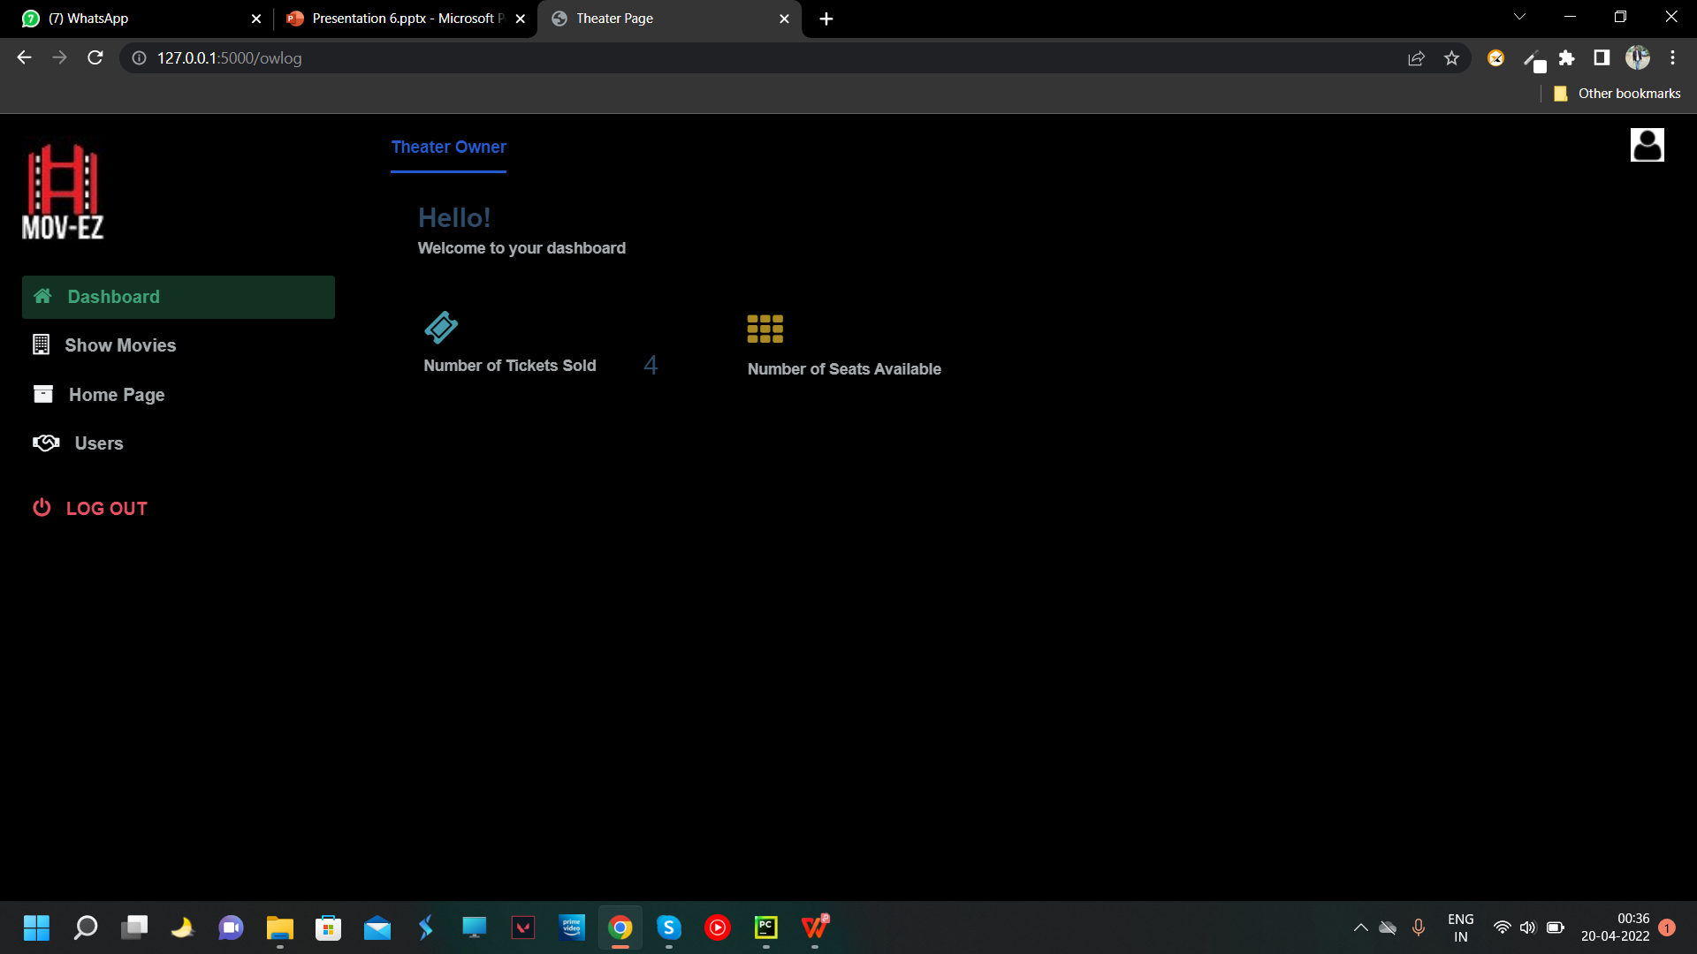
Theater Owner Home:

Slide 23
Technology Used:
Technology Used:
Python: It is an open source high level programming language.
Flask: It is an open source, web development frame work.
Sqlite3: It is used for Database storage.
Html: It is used to create the web page.
CSS: It is used to design the web page.
JavaScript: It is used to make web page interactive. page.

Slide 24
System Implementation:
Implementation is the stage of the project when the theoretical design is turned out into a working System. Thus it can be considered to be the most critical stage in the achieving a successful new system.
The implementation stage involve care full planning, investigation of the existing system and it’s constraints on implementation, designing of methods to achieve change over methods.

Slide 25
System Testing:
Testing is the process of exercising software with the intent of finding and correcting errors.
System testing is required for any applications because it gives assurance about the execution and performance.
System Testing is carried out on the whole system in the context of either system requirement specifications or functional requirement specifications or in the context of both.

Slide 26
Testing Pre-requisites:
Requirement Traceability:
It includes: Customer requirements, Functional and non – Functional requirements, Status, Architectural design etc.
Test Plan:
It includes: Test case title, Description, Free conditions, User actions, Expected and actual outcome and Status.
Defect Tracker:
It includes: Log file of the failed test cases.
Release Note:
It includes: Introduction about the project, Compatibility, Upgrades and New features.

Slide 27
Robot Framework:
Robot Framework is a generic open source automation framework.
It can be used for test automation and robotic process automation.
For testing of our project we have used robot framework.
In our project we have used selenium library, keywords, settings, variables.

Slide 28
Conclusion:
Nowadays, traditional reservation ways of movie ticketing is dying. Its new age where technology dominates human life.
With the software and technological devices, exceptions are reduced and even terminated. Also, people prefer easy, quick and safe way for every part of his life.
This project is designed to meet the requirements of a movie ticket booking system.
With this platform, we are hoping to reduce time wasting, avoid misunderstandings, provide easy data flow, customer pleasure, and less hard work.
We believe that we have accomplished our goals and satisfied with the code we developed.

Slide 29
Future Enhancement:
It can be implemented for various theaters simultaneously having multiple screens.
Chat bot can be trained in a better way to help the customers using machine learning in an effective way.
Payment facility for bank to user.
Website can be automated.

Slide 30
